Slide 1



Verification of AI: The Alpha-Beta Crown
Presenter - Jawwad Pathan
Guide – Ashutosh gupta

Slide 2
Alpha-Beta CROWN
The Alpha-Beta CROWN is the state-of-the-art tool used to verify the robustness of neural networks.
The tool is proved to have outperformed all the currently available tools in various competitions held for neural network verification.
It uses complex mathematical ideas and optimizations to achieve this performance
The chain of research paper that describes the tool covers the almost the ideas in the field of verification of AI.

Slide 3
List of papers
H. Zhang, T.-W. Weng, P.-Y. Chen, C.-J. Hsieh, and L. Daniel. Efficient neural network robustness certification with general activation functions. In Advances in Neural Information Processing Systems (NeurIPS), 2018
Vincent Tjeng, Kai Xiao, and Russ Tedrake. Evaluating robustness of neural networks with mixed integer programming. ICLR, 2019
K. Xu, H. Zhang, S. Wang, Y. Wang, S. Jana, X. Lin, and C.-J. Hsieh. Fast and complete: Enabling complete neural network verification with rapid and massively parallel incomplete verifiers. International Conference on Learning Representations (ICLR), 2021.
Wang, S., Zhang, H., Xu, K., Lin, X., Jana, S., Hsieh, C.-J., and Kolter, J. Z. Beta-crown: Efficient bound propagation with per-neuron split constraints for complete and incomplete neural network verification. Advances in Neural Information Proessing Systems (NeurIPS), 2021.
K. Xu, Z. Shi, H. Zhang, Y. Wang, K.-W. Chang, M. Huang, B. Kailkhura, X. Lin, and C.-J. Hsieh. Automatic perturbation analysis for scalable certified robustness and beyond. Advances in Neural Information Processing Systems (NeurIPS), 2020
H.Zhang, S.Wang, Kaidi Xu, L. Li, B. Li, S. Jana, J. z. Kolter. General Cutting Planes for Bound-Propagation-Based Neural Network Verification. Neural Information Processing Systems (NeurIPS 2022).

Slide 4
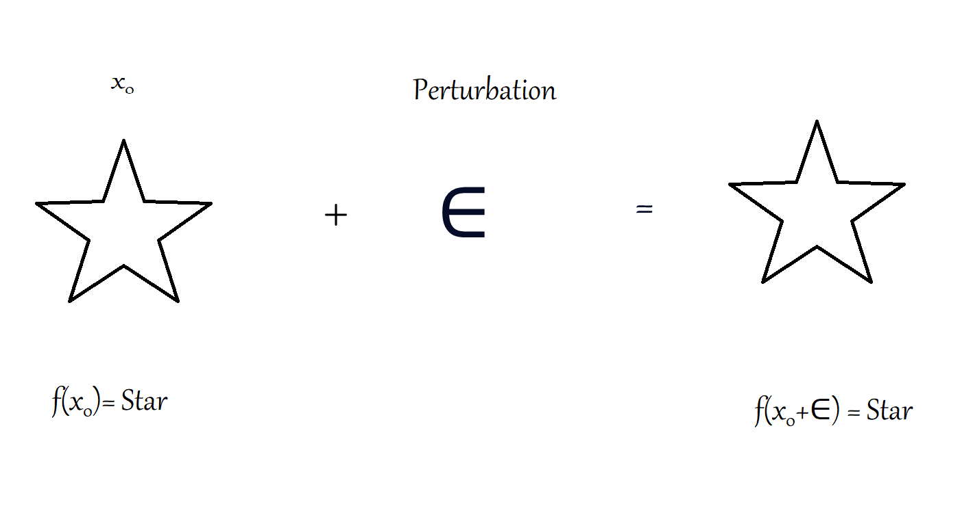
Robustness

Slide 5
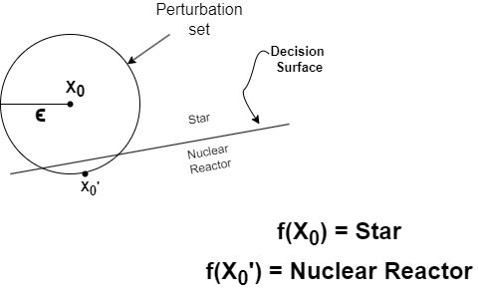
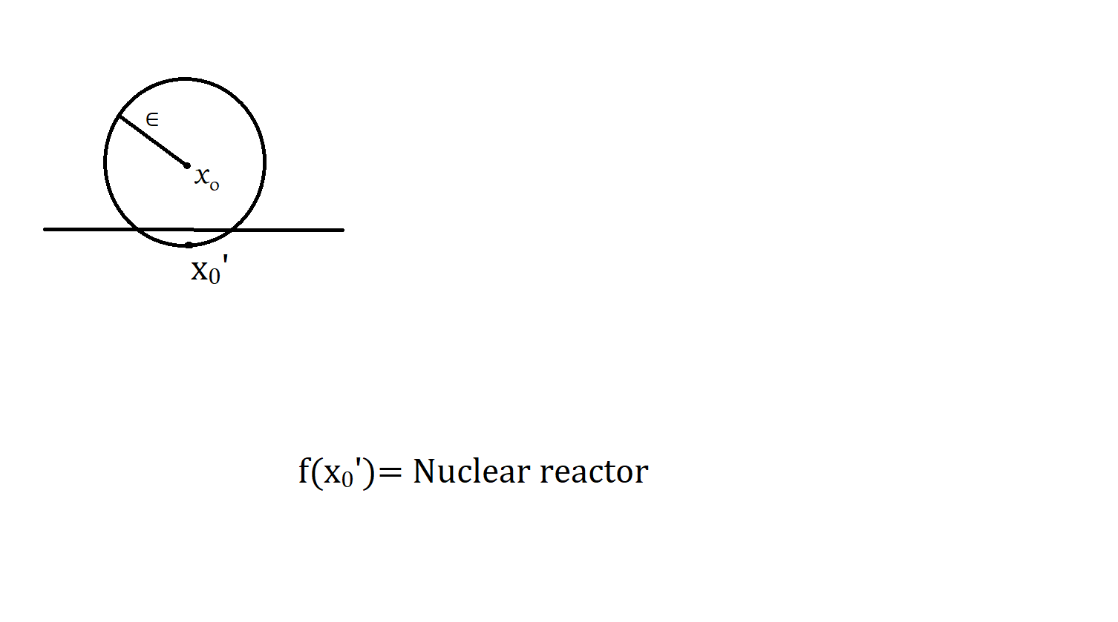
What can go wrong

Slide 6
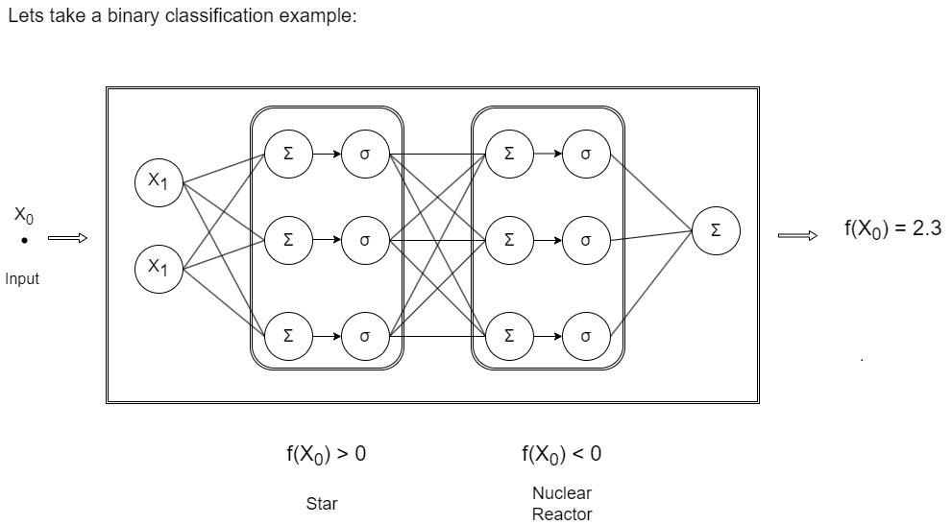
Problem Formulation
Lets take a binary classification example :

Slide 7
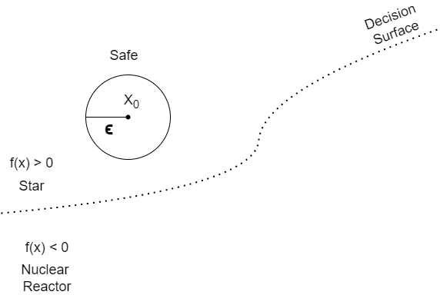
Problem Formulation
We saw f(X₀) > 0. We need to verify :
f(x) > 0, ∀x ∈ C (Perturbation set)

Slide 8
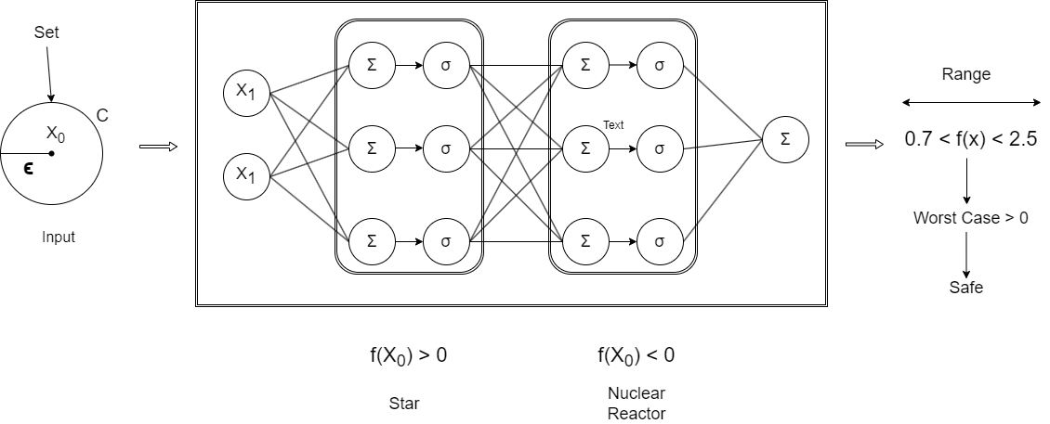
Problem Formulation
We saw f(X₀) > 0. We need to verify :
f(x) > 0, ∀x ∈ C (Perturbation set)

Slide 9

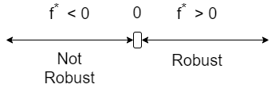
Problem Formulation
Since we have f(X₀) > 0, our problem boils down to :
C is the perturbation set which is define as, C= {x | ∥x - X₀∥_{P} ≤ ϵ}

Slide 10
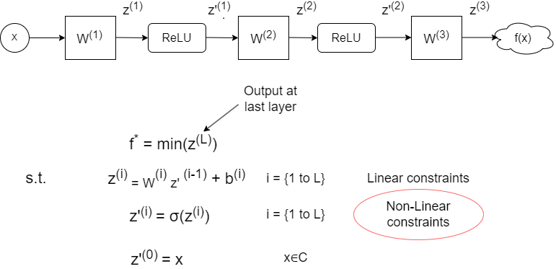
Analyzing Challenges

Slide 11
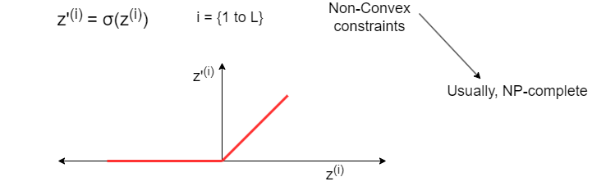
Analyzing Challenges
Suppose σ = ReLU,

Slide 12
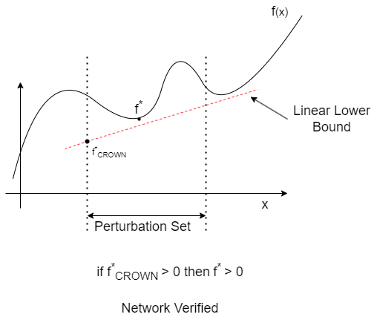
Alpha-Beta Crown
We need to find the lower bound of f(x) i.e. f*_{CROWN} .

Slide 13
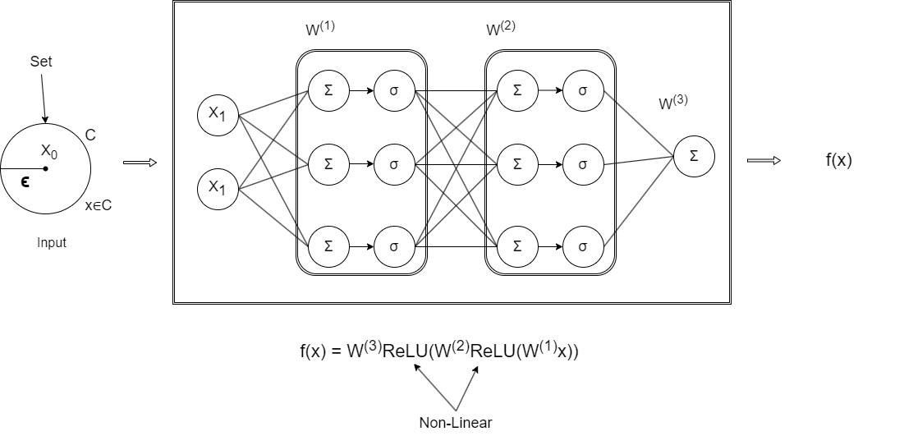
ReLU Relaxation

Slide 14
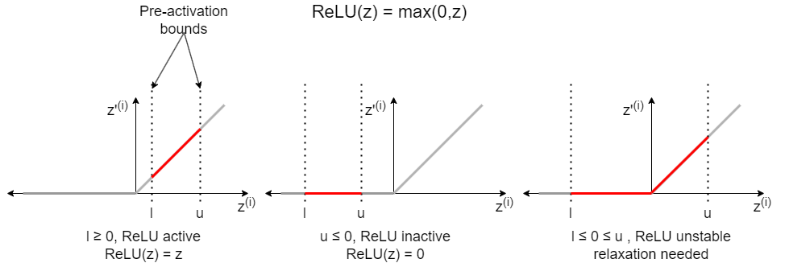
ReLU Relaxation
Three Cases of ReLU :

Slide 15
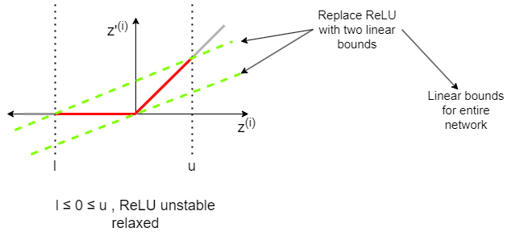
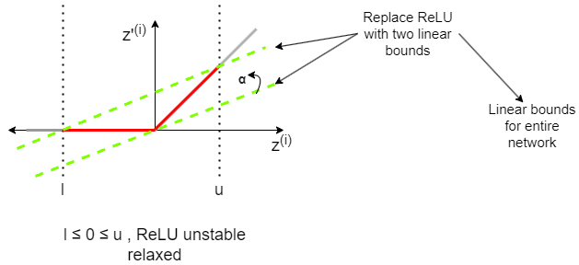
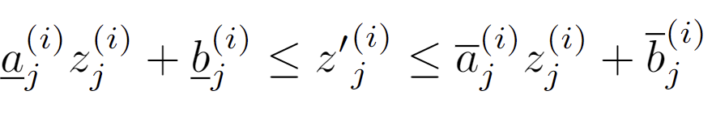
ReLU Relaxation

Slide 16
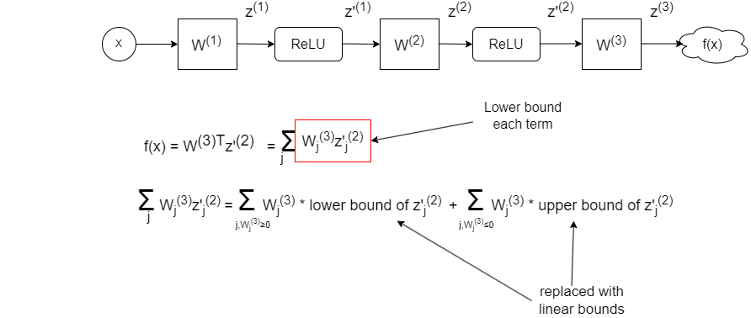
ReLU Replacement

Slide 17
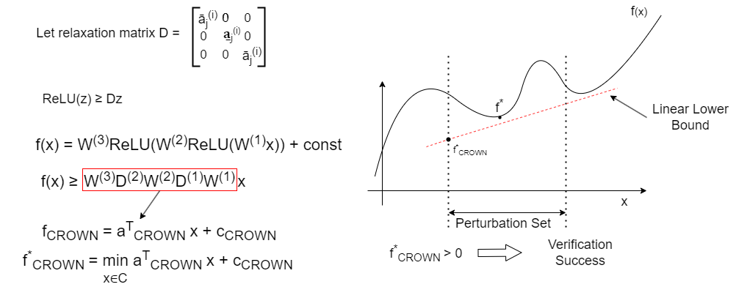
Linear Formulation of Crown

Slide 18
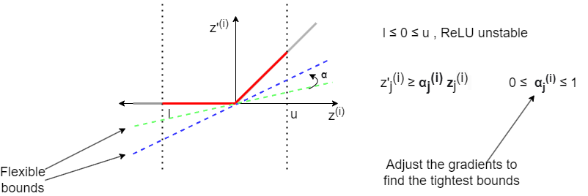
Flexible lower bounds

Slide 19
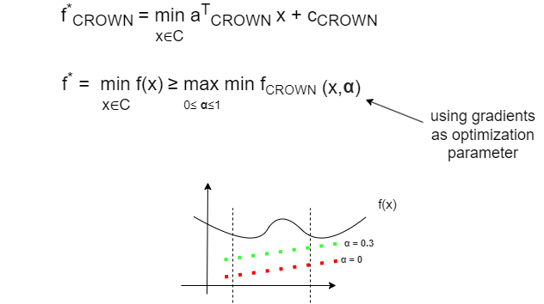
Optimization using gradients

Slide 20
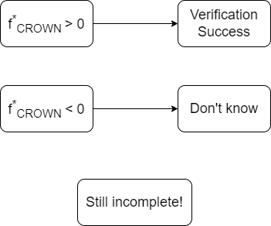
Incompleteness of α-CROWN

Slide 21
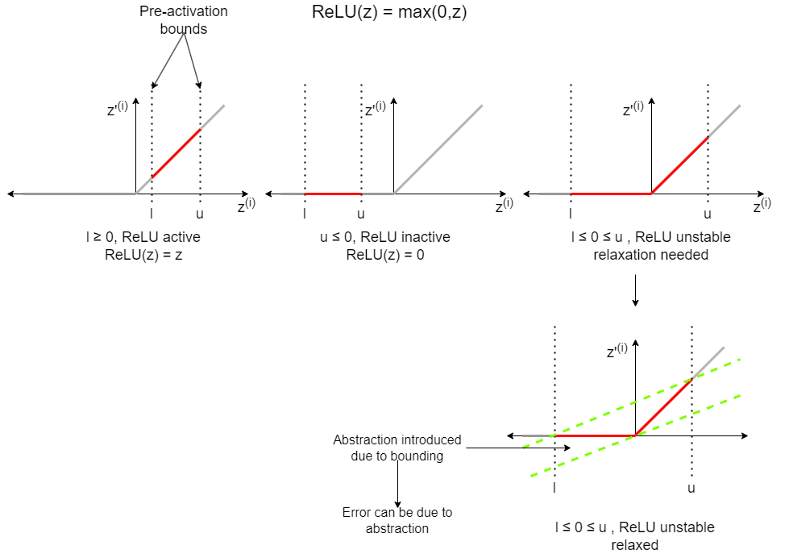
Branch and Bound for ReLU

Slide 22
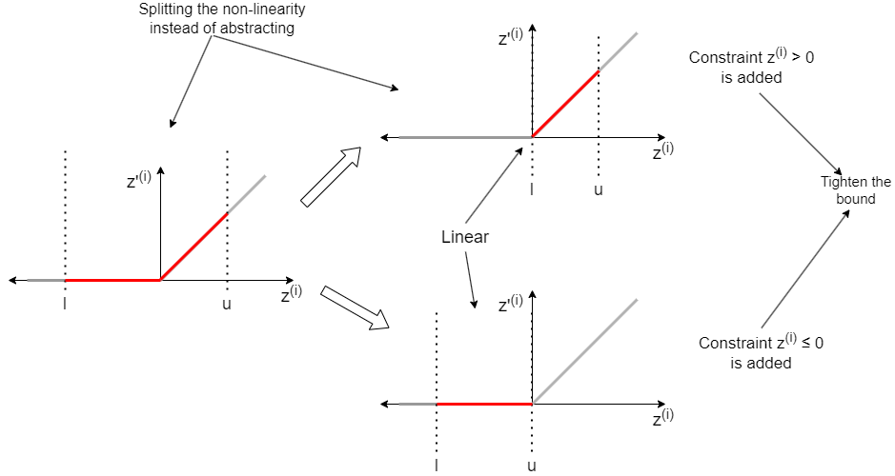
Branch and Bound for ReLU

Slide 23
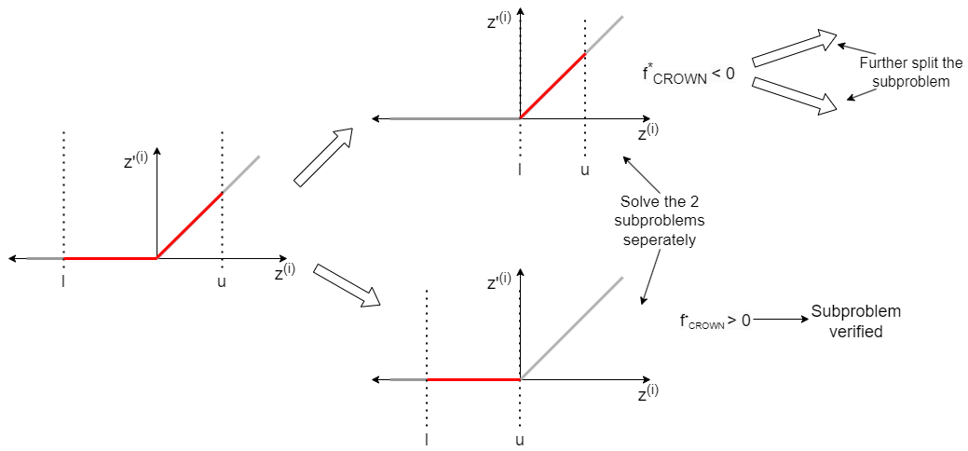
Branch and Bound for ReLU

Slide 24
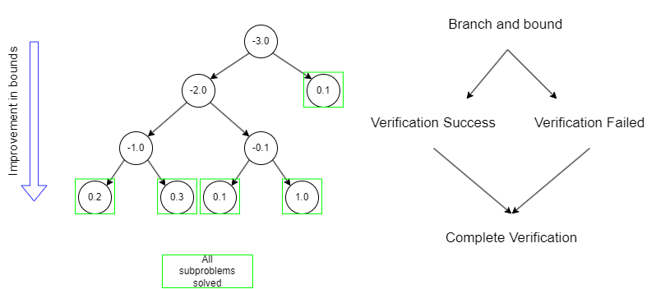
Branch and Bound Completeness

Slide 25
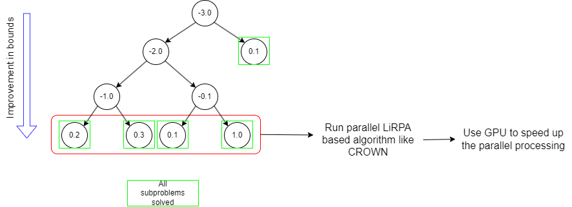
Parallelization using LiRPA

Slide 26
Split Constraint Optimization

Slide 27
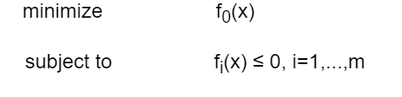

Lagrange multipliers
Let’s see an optimization problem –
The Lagrangian function for the above optimization is defined as –
λ_{i} ’s are lagrangian multipliers

Slide 28
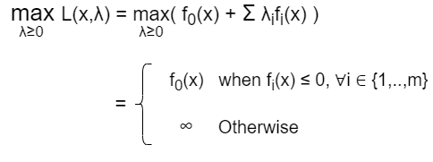
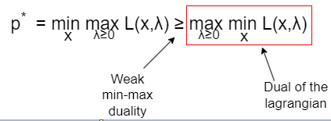
Lagrange multipliers
Maximize the lagrangian function –
Minimize the whole equation -

Slide 29
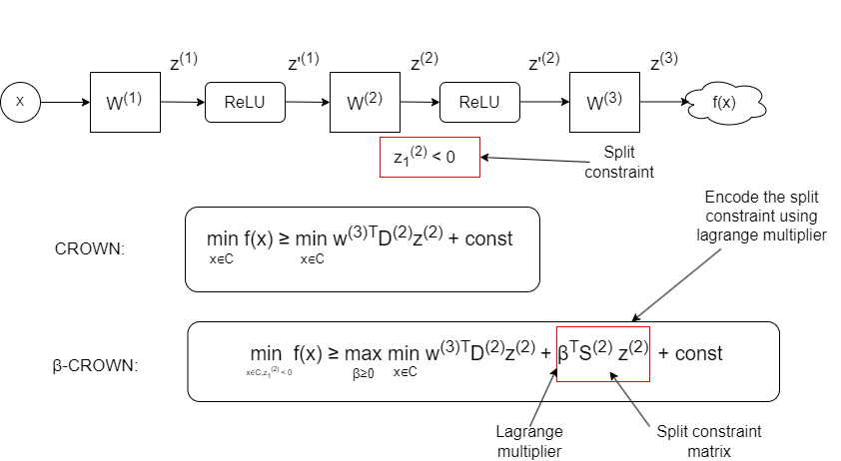
Split Constraint Optimization

Slide 30
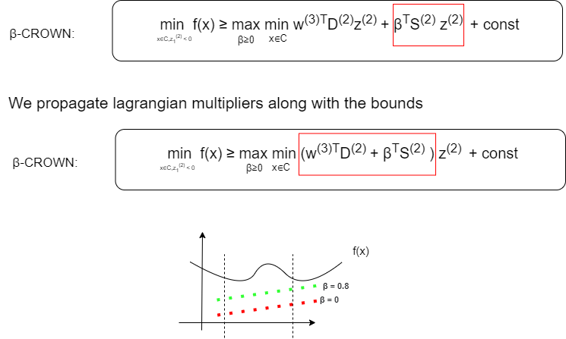
Split Constraint Optimization

Slide 31
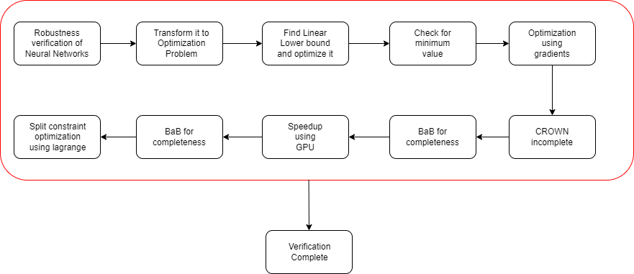
Conclusion

